Slide 1
eVAL 2.0
Preview oF 2.0 functionality. This is a very early preview and is subject to change.

Slide 2
Site Navigation
Choosing a Work Area, working in the context of a selected teacher

Slide 3
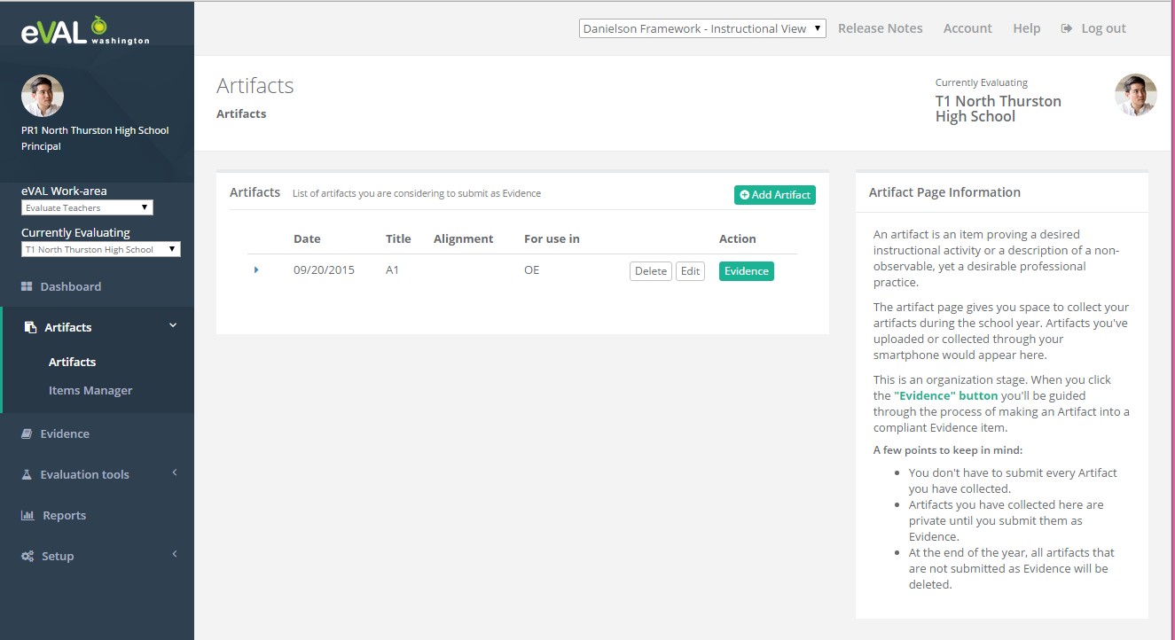
Page Layout
Left Navigation Bar
Page Title/Breadcrumbs
Active User
Currently Evaluating
Active Work Area
Currently Evaluating
Main Content
Contextual Help

Slide 4
Page Layout – Selecting a Work Area
Active Work Area
The user will always be working in the context of a Work Area. The left navigation bar options will changed based on the selected Work Area.
For some Work Areas there will be additional settings. For example, a principal that is in the “Evaluate Teachers” Work Area, will need to further select the teacher he will be evaluating.

Slide 5
Page Layout – Selecting a Teacher
Currently Evaluating
The Currently Evaluating dropdown allows the principal to select the teacher to evaluate.
Once a teacher has been selected, the selected teacher’s profile will be displayed in the upper right of the screen.

Slide 6
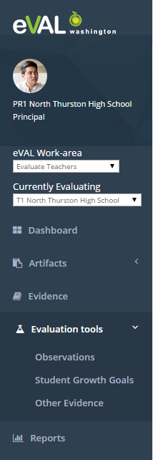
Working on a Selected Teacher
Once a teacher has been selected by the principal, the teacher’s evaluation is active. The principal’s left navigation menu options will all relate to activities for the active evaluation.
Artifacts: The principal can create/manage artifacts related to the teacher’s evaluation. These artifacts are private to the principal until he submits them as Evidence.
Evidence: The principal can manage/evaluate Evidence (submitted artifacts) from both himself and the teacher. Artifacts in this area include both stand-alone artifacts, or those attached to a primary object.
Evaluation Tools: The principal can work with primary types of Evidence related to the teacher’s evaluation, such as Observations, Student Growth Goals, and Other Evidence (stand-alone artifacts).

Slide 7
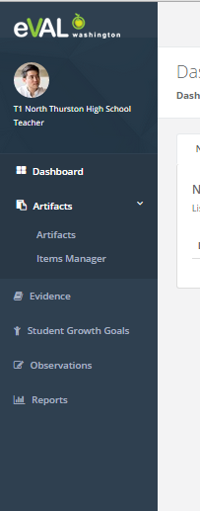
Working as a Teacher
The teacher has a similar left navigation menu as the principal when the teacher is selected.
Artifacts: The teacher can create/manage artifacts related to his evaluation. These artifacts are private to the teacher until he submits them as Evidence.
Evidence: The teacher can manage/evaluate Evidence (submitted artifacts) from both himself and the teacher. Artifacts in this area include both stand-alone artifacts, or those attached to a primary object.
Student Growth Goals: The teacher can work on student growth goals and submit finalized goals to be visible to the principal.
Observations: The teacher can see observations that have been completed or are in progress or scheduled.

Slide 8
Artifacts
Creating, Submitting, Evaluating ARTIFACTS

Slide 9
Artifacts - Summary of Changes
Creating Artifacts
Evaluator created Artifacts
Reduced the number of input fields
Professional Practice Items
Artifact Bundles (multiple items within an Artifact)
Item Manager
Attaching Artifacts to Observations, Goals, …
Enhanced File Upload support
Enhanced Artifact Alignment/Evidence
Workflow
Submitting Artifacts as Evidence
Rejecting (need a better term) Artifacts
Evaluating Artifacts (by either principal or teacher)
Tracking Artifact Status

Slide 10
Artifacts – Evaluator Created Artifacts
In version 1, the evaluator does not have a way to create a stand-alone artifact related to a teacher’s evaluation.
In version 2, both the principal and the teacher have an Artifacts area where they can create Artifacts related to the evaluation. In particular, the principal can create Artifacts that are not attached to an Observation or Goal.
We call these Artifacts “Other Evidence”.

Slide 11
Artifacts – Simplify Data Fields
System ID: an ID to uniquely identify an Artifact. 2015-2016.1, 2015-2016.2,…
Title: The title describing the Artifact
Context: Describes the setting, purpose, and background of the artifact.
Alignment: Align to one or more rubric components from the Instructional Framework.
Alignment Evidence: Describe what the Artifact is evidence of and justification for the alignment choices.

Slide 12
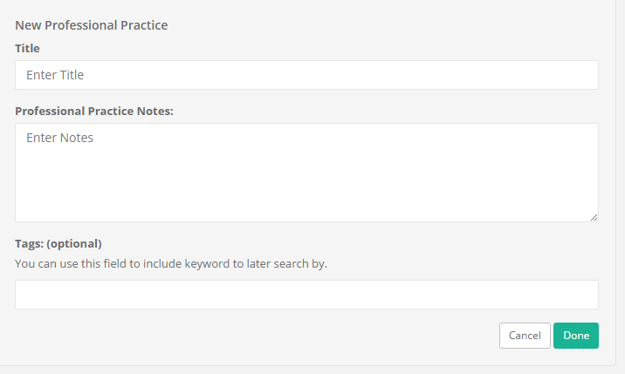
Artifacts -Professional Practice Items
In addition to files and web links, we will support a new type of item called Professional Practice. It is a self-documented activity that is described as a narrative within the artifact creation process. Most often this type of item is used for documenting an activity that take place outside of the classroom, such as documenting a professional practice. An example might be that the teacher wants to document that she is in a leadership position at her school..

Slide 13
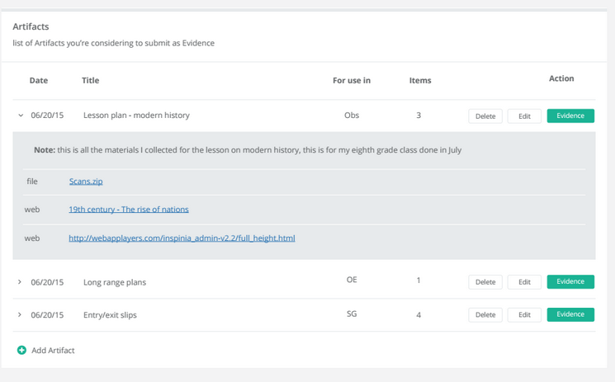
Artifacts - Artifact Bundles
In version 1, we allow a single file or web link to be associated with an Artifact. In version 2, we support associating multiple items with a single Artifact.
We call this an Artifact Bundle.
This can be useful when you have a group of related items that should be reviewed as a bundle rather than individually.

Slide 14
Artifacts - Item Manager
There has been requests to be able to associate an Artifact with multiple objects in eVAL.
Rather than re-use an Artifact in multiple places, we have provided a central location to manage each of the underlying items that are part of the Artifacts and allow the user to re-use these items in new Artifacts with potentially different alignment choices.
Each file, web link and professional practice item that is created in the context of an Artifact is available within the Item Manager.

Slide 15
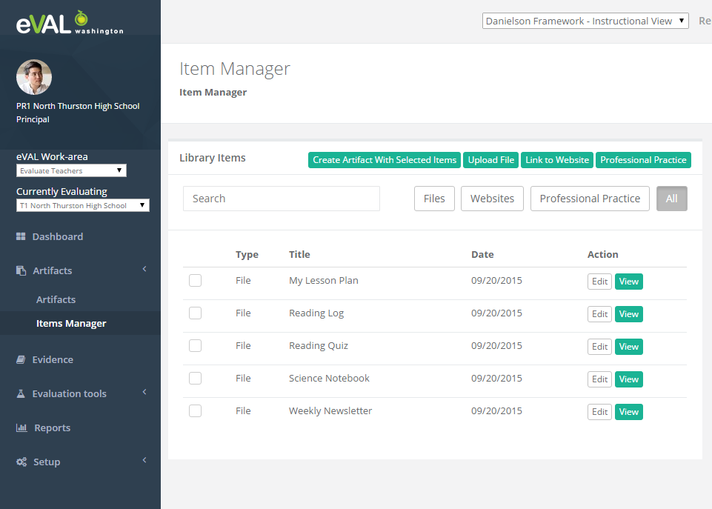
Artifacts - Item Manager
Individual Items can be search and viewed separately from the Artifacts they are used in.
Items in the Item Manager can be re-used to create other Artifacts.

Slide 16
Artifacts – Attaching to Objects
Attached Artifacts – Linked to a Primary Evidence Item
Artifacts that are attached to Observations, Goals, or Self-Assessments are supporting documentation for the primary type of evidence. Examples might include a lesson plan used during the observation, a goal-planning worksheet, a photo taken during taken during the observation, or assessment data to support the student growth goals.

Slide 17
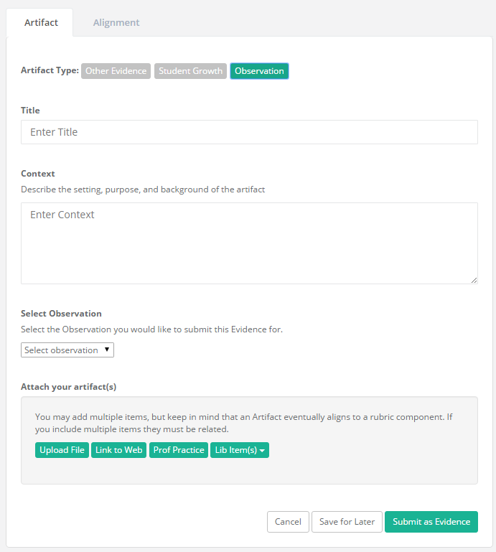
Artifacts - Link to a Observation
Selecting an Observation
A dropdown is provided for the user to select the observation to attach the Artifact to.
The artifact can also be created and attached from within the Observation.

Slide 18
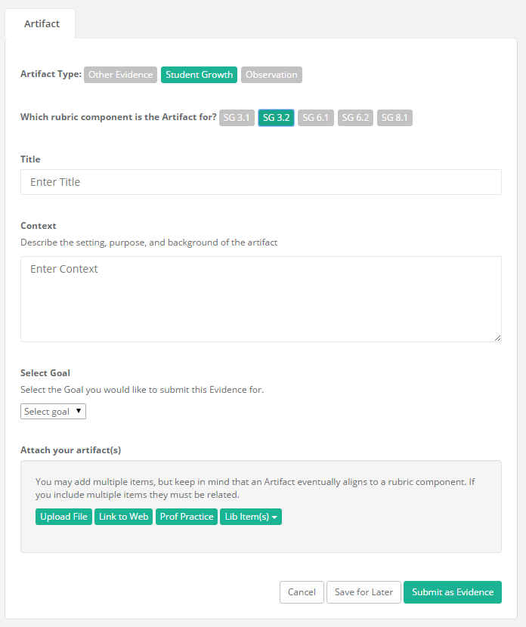
Artifacts - Link to a Student Growth Goal
Selecting a Goal
A dropdown is provided for the user to select the goal to attach the Artifact to.
The artifact can also be created and attached from within the Goal.

Slide 19
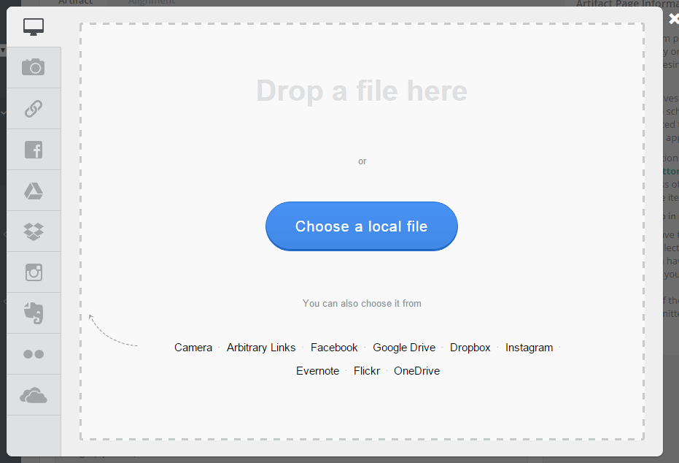
Artifacts - Uploading Files
We have enhanced the functionality associated with uploading files within Artifacts:
We allow users to upload files from popular external sources, such as Facebook, Google Drive, Instagram. The sources will be configurable by the district.
We’ll also support drag and drop from the user’s desktop to the upload target.

Slide 20
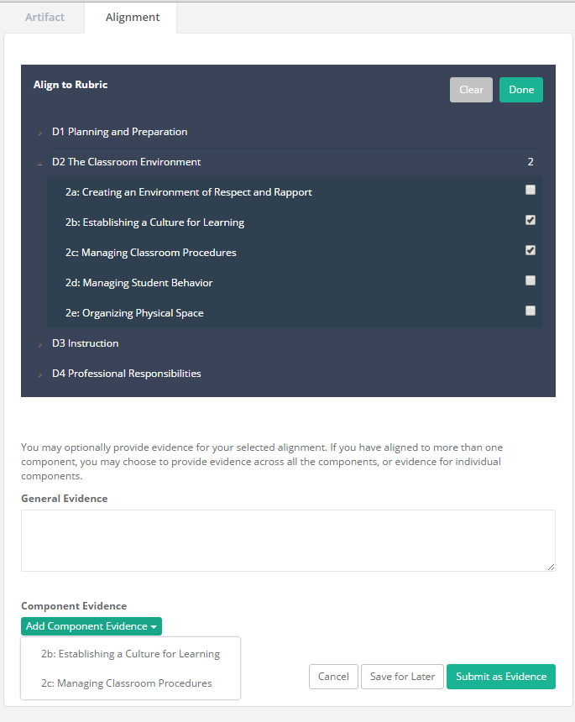
Artifacts - Alignment/Evidence
The teacher is required to align each Artifact with one or more of the Instructional Framework rubric components.
Additionally she has the opportunity to add evidence to support her alignment choices at both a general level and for each specific rubric component.

Slide 21
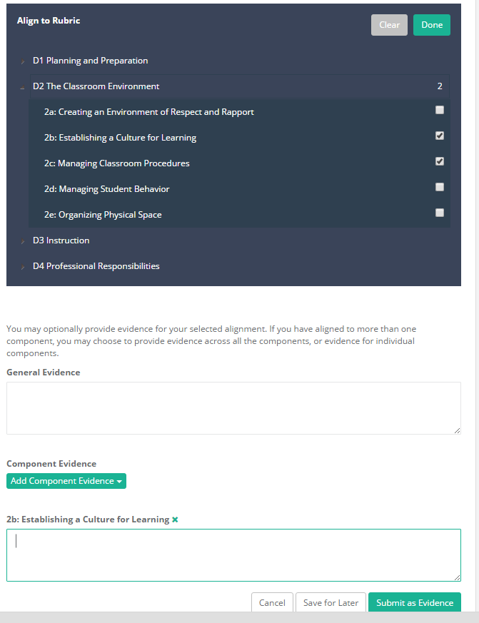
Artifacts - Avoiding Over-alignment
One practice we noticed when looking at alignment activity for past artifacts is that users often have a tendency to align an artifact widely rather than to a small number of rubric components.
Adding the ability to input evidence for each rubric component will hopefully guide the user toward aligning with components that have evidence to support the alignment.
At the same time we don’t want to require that each component have supporting evidence. And in the case when the alignment can have a single general statement they can use the General Evidence in place of the component-specific evidence input areas.

Slide 22
Artifact Workflow
Artifacts now go through a flow within eVAL that allows users to track where it is in the overall process.
Workflow Overview
Teacher or Principal create a new Artifact (stand-alone or attached to an object within eVAL)
User submit the Artifact as Evidence
Principal can choose not to use an Artifact submitted by the teacher or asks for modifications to alignment
Principal and/or teacher optionally choose to evaluate submitted Artifacts
Artifact evaluation data is aggregated in final summative evaluation data.

Slide 23
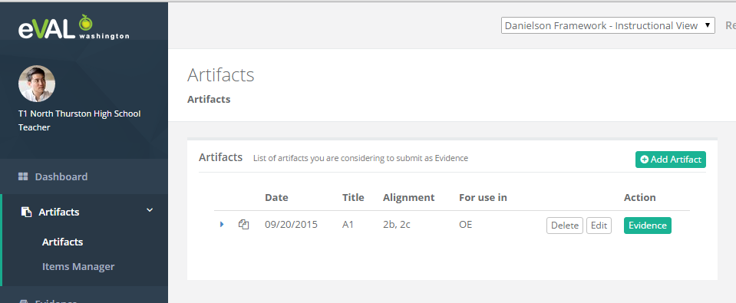
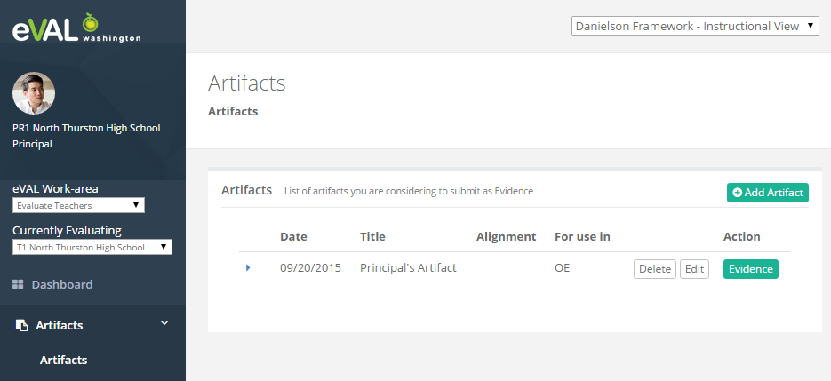
Workflow – Creating Artifacts
Both the teacher and principal can create Artifacts that support the teacher’s evaluation.
Artifacts are private to the creator until the Artifact is submitted as Evidence.

Slide 24
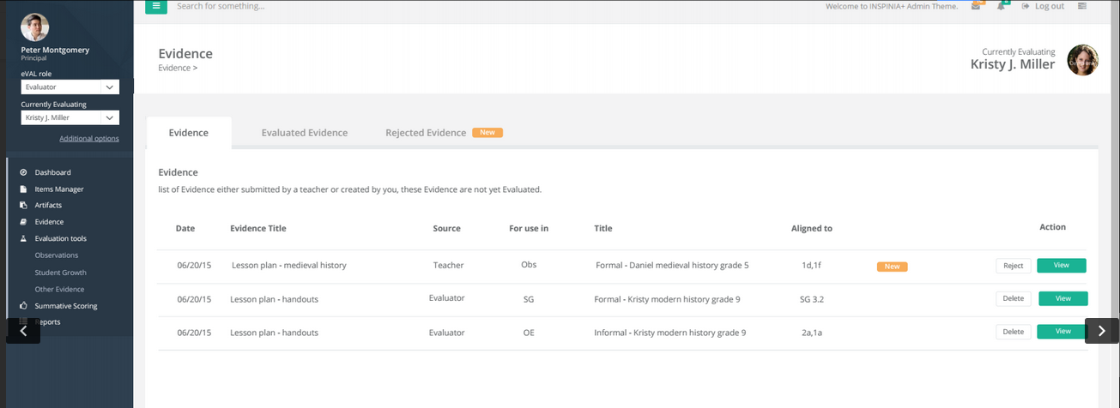
Workflow – Submitting Artifacts
Once the Artifact is submitted it no longer appears in the Artifacts section. It is only visible in the Evidence section.
Artifact in the teacher’s Evidence section are visible to the principal.
Once submitted, the teacher and principal can both track the evaluation of the Artifact.

Slide 25
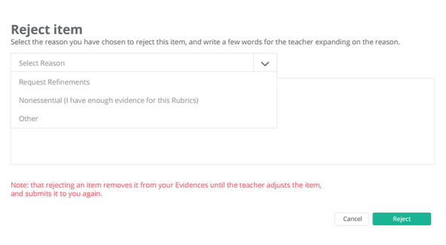
Workflow - Not Using Artifacts
Principals can decide that an Artifact will not be used in the teacher’s evaluation.
Reasons for not using an Artifact
Non-essential: the principal already has sufficient evidence for the aligned components and the Artifact does not demonstrate new performance.
Request refinement: the principal would like to have the teacher consider an alternate alignment or limit the alignment.
Other

Slide 26
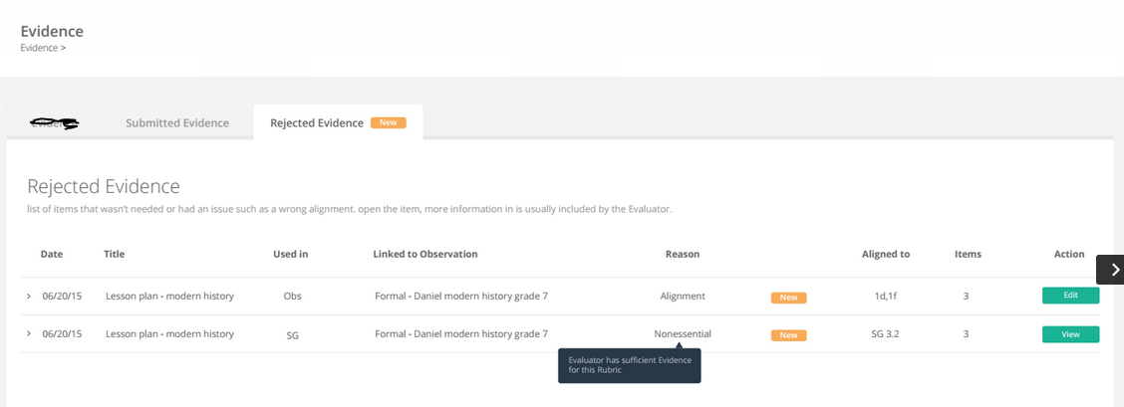
Workflow - Not Using Artifacts
The teacher will have a dashboard screen that shows the status of all Not-used Artifacts.

Slide 27
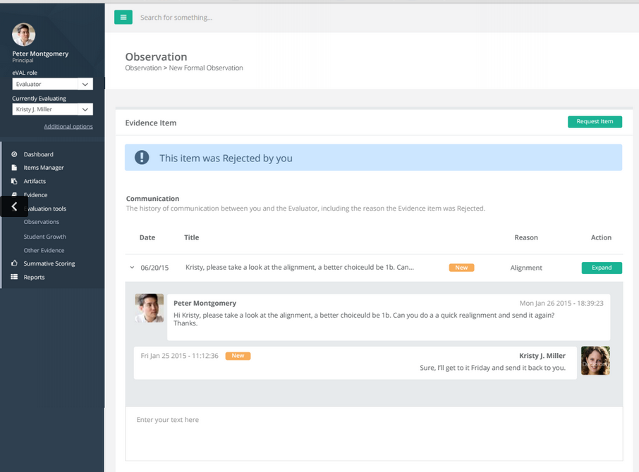
Workflow - Non-used Artifacts
When a principal sends an Artifact back to the teacher, the principal and teacher can correspond about the reason and work toward the teacher re-submitting the artifact.
Once the issue is resolved, the teacher can then re-submit the artifact.

Slide 28
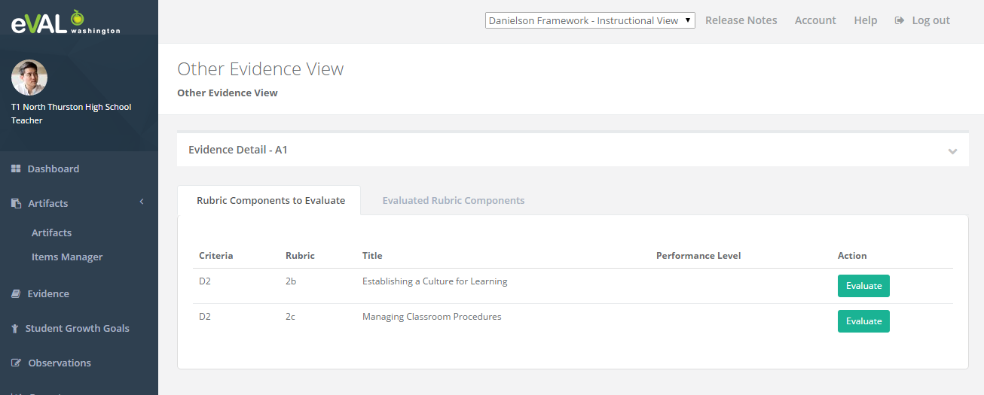
Workflow - Evaluating Artifacts
Both the principal and the teacher will be given the opportunity to evaluate Artifacts.
This will likely be an infrequent activity for teachers, but we wanted to provide a unified approach to evaluating items that are aligned to the framework.
An evaluation is done in the context of a rubric component that the Artifact is aligned to.
For each rubric component, the user can do as little or as much evaluation as they want.
For a given rubric component, the user can indicate that he has completed the evaluation for that component.

Slide 29
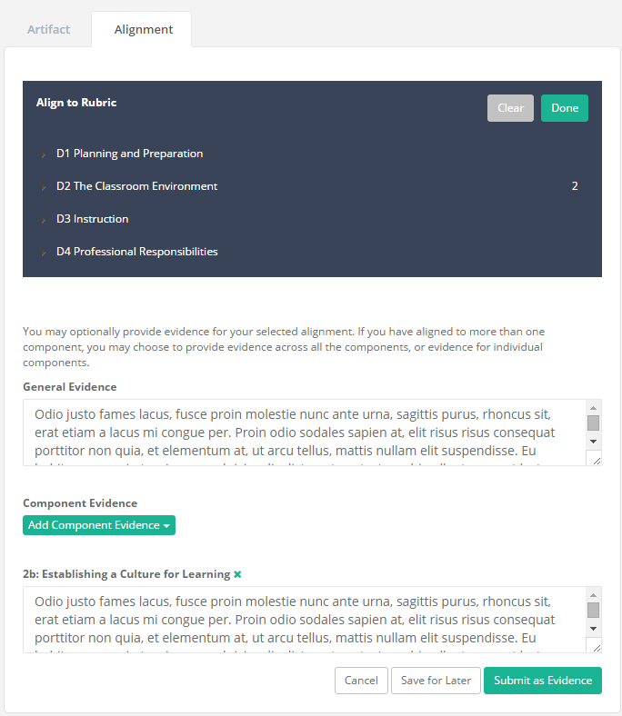
Evaluating Artifacts- Supporting Evidence
When the user clicks on the Evaluate button for a rubric component, the evaluation screen will display the supporting evidence that the teacher entered while aligning the Artifact.
The screen on the left shows what the teacher entered during the Artifact Alignment Process.
The next screen will show how it is incorporated into the Evaluation View.

Slide 30
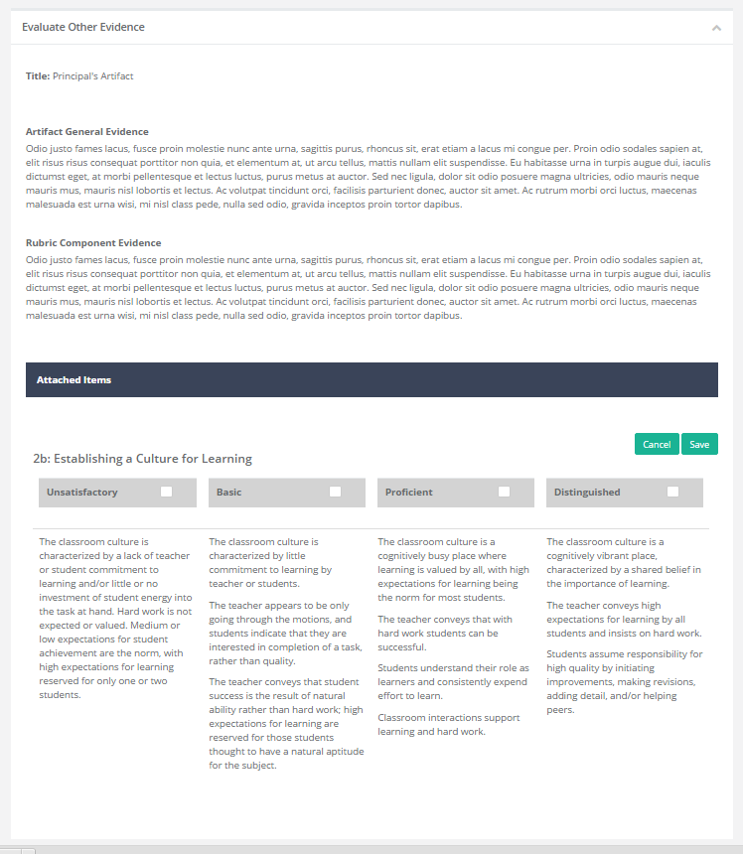
Evaluating Artifacts- Supporting Evidence
When the user clicks on the Evaluate button for a rubric component, the evaluation screen will display the supporting evidence that the teacher entered while aligning the Artifact.
The screen on the left shows what the user sees when evaluating the Artifact. In this case the teacher entered both General Evidence and Component-specific Evidence and they are both displayed here.

Slide 31

Evaluating Artifacts- Aligned Evidence
Aligned Evidence is a new term we have introduced to describe the process of aligning supporting evidence to the rubric descriptor text.
There are two parts:
Rubric Statement: the rubric descriptor text that aligns with the teacher’s performance
Supporting Evidence: supporting evidence that comes from either the teacher’s input or the evaluator.
The user can create one or more Aligned Evidence items associated with the rubric component.

Slide 32
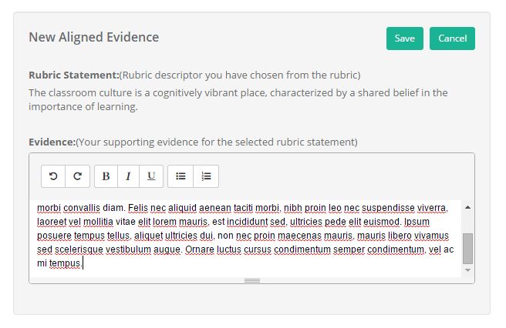
Evaluating Artifacts- Aligned Evidence
When the user selects the rubric statement from the rubric descriptor text, an input area will appear allowing them to add their supporting evidence.
Our plan is to have toolbar buttons on the editor that will allow the user to quickly copy/paste the General or Component-Specific Evidence the teacher provided during alignment into the Evidence input area.

Slide 33
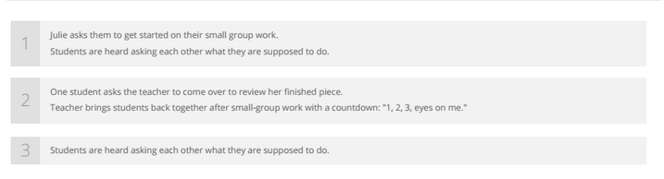
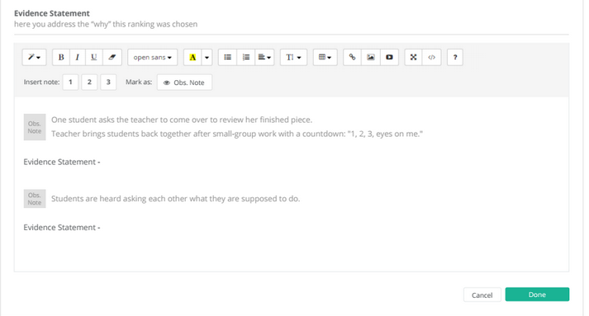
Evaluating Artifacts- Aligned Evidence
This is taken from the Observation mock-up screen, but the same idea would apply to Artifacts. In this screen, each numbered item is evidence that was taken from the Observation Notes.
The second screen shows how the evidence items from the Observation notes each appear as a numbered item on the toolbar. Clicking on the toolbar button would insert the observation note into the Evidence area (note: the Evaluation Statement within the editor text is meant to represent any additional text that the user might enter).

Slide 34
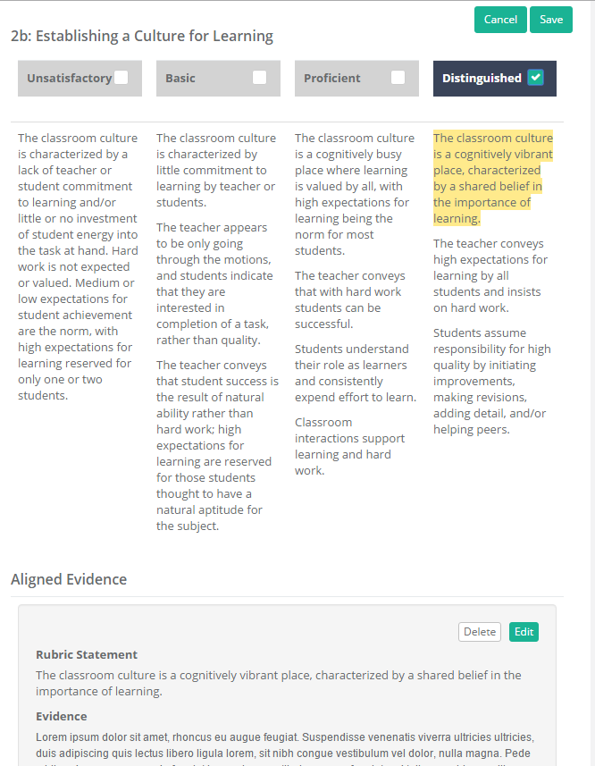
Evaluating Artifacts- Aligned Evidence
The user can select rubric descriptor text and align it to supporting evidence multiple times.
All of the highlighting and Aligned Evidence items will be displayed.
The user can either Save his input and return later, or finalize his evaluation by clicking the “Done” button (not show here).

Slide 35
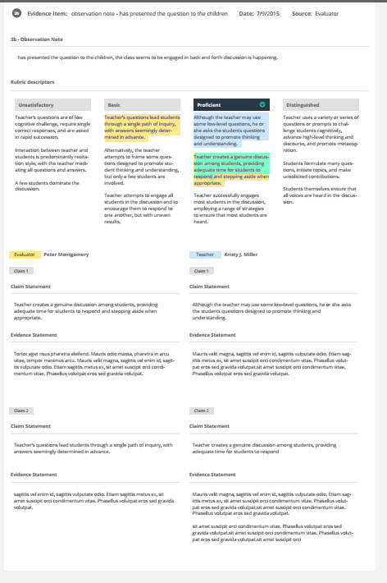
Artifacts Summary – Combined View
At any point the teacher and principal can view a Summary of the Artifact. In addition to the main data fields of the Artifact, the evaluation data will also be displayed, combining both the principal and teacher’s input if they exist.

Slide 36
Artifact Evaluation Questions
Is it necessary to have a separate Evidence/Notes input area, or can all input be in the context of an Aligned Evidence item?
We discussed one difference between the Danielson Framework and CEL/Marzano being that Danielson has fewer components, with each component having multiple paragraphs.
Would it make sense for a CEL/Marzano evaluator to just have to click the rubric component performance level that they want and then the Aligned Evidence input box would come up automatically with the entire rubric component descriptor paragraph selected?
For all frameworks, would it be possible to make a restriction that the user must select at least one sentence within the rubric component descriptor text? This is necessary to support merging highlights from both the teacher and principal. We need to store the highlighting independent of the rubric descriptor text and overlay all of the highlighting. This means that we need to ensure that each individual highlight represents a unique string within the rubric descriptor text.

